Slide 1
Commercial project ‘marketplace’
Kuzmenko Andrey

Slide 2
Info
I wrote this marketplace from scratch for the customer, he only needed a backend, after developing the backend part, I decided to create a small frontend for my portfolio. I used PHP, Laravel, MySQL, AJAX, JavaScript/JQuery, HTML, CSS, Bootstrap, GIT

Slide 3
Information before viewing
The marketplace is located locally, so only screenshots, some screenshots may be jagged due to their size! I can show you more via video!

Slide 4
Programming languages
PHP
Laravel
MYSQL
JS,
Jquery,
AJAX
BOOTSTRAP 5
HTML, CSS

Slide 5
Database
Tables:
pages, page_blocks, page_block_settings, users, roles, resolution_for_main_roles, user_roles, business_accounts, chat, chat_messages, categories, category_brands, category_required_sections, category_variations, products, product_blocks, title_blocks, product_characteristics, product_images, product_videos, comments, cart, orders, status_orders, favorites, main_categories, banner, reports, questions, application_for_new_brands, notifications, news, news_blocks, migrations.

Slide 6
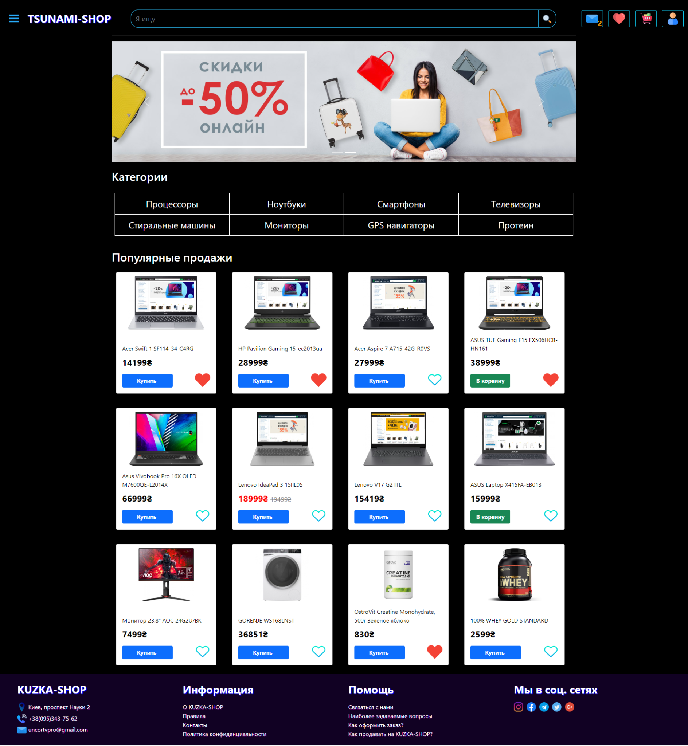
Main Page

Slide 7
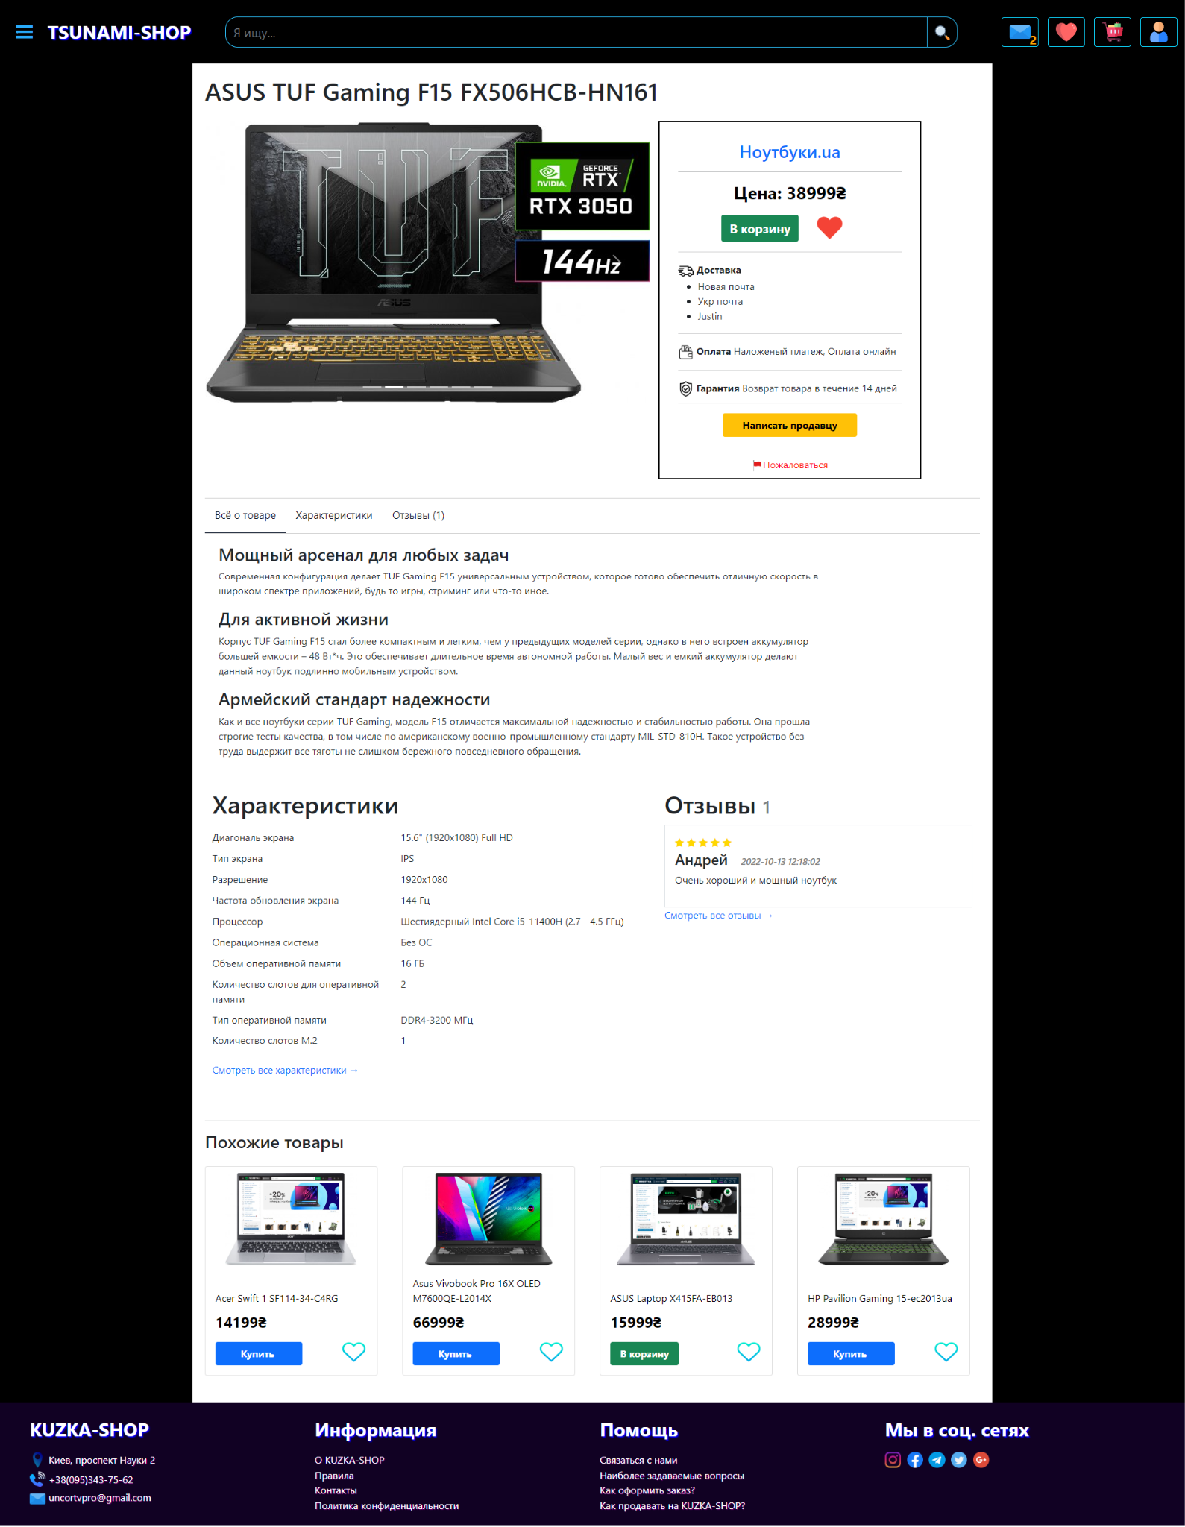
Product page

Slide 8
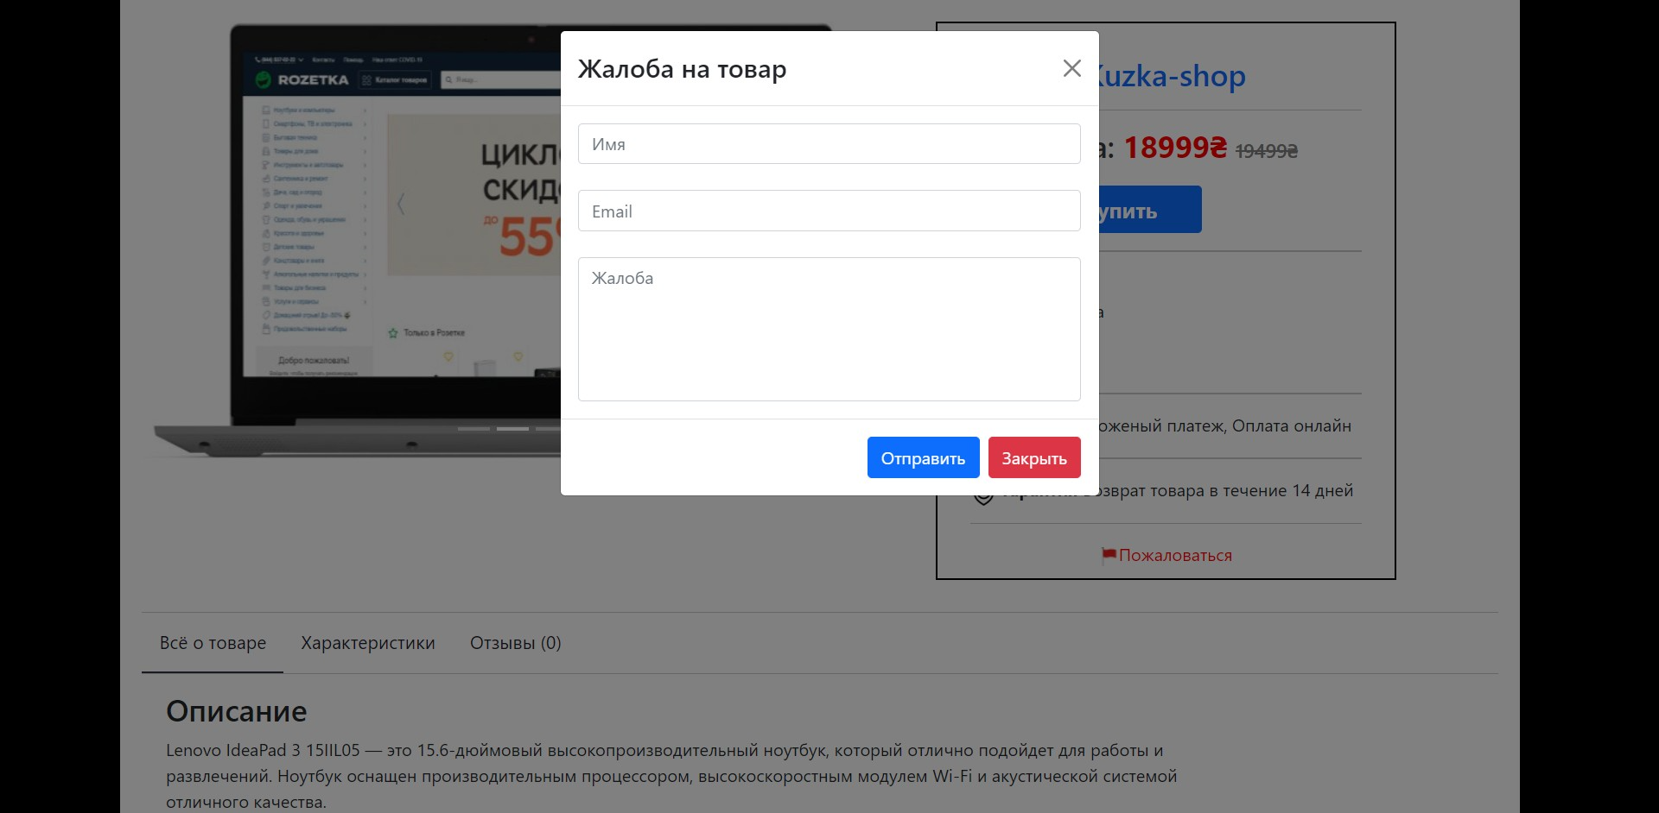
Product complaint

Slide 9
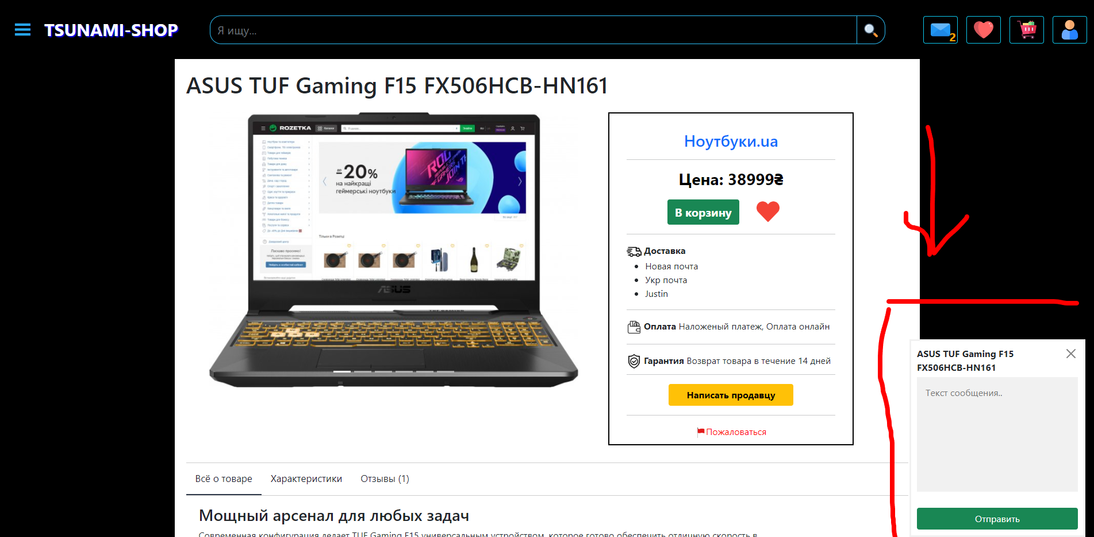
Write to shop(chat)

Slide 10
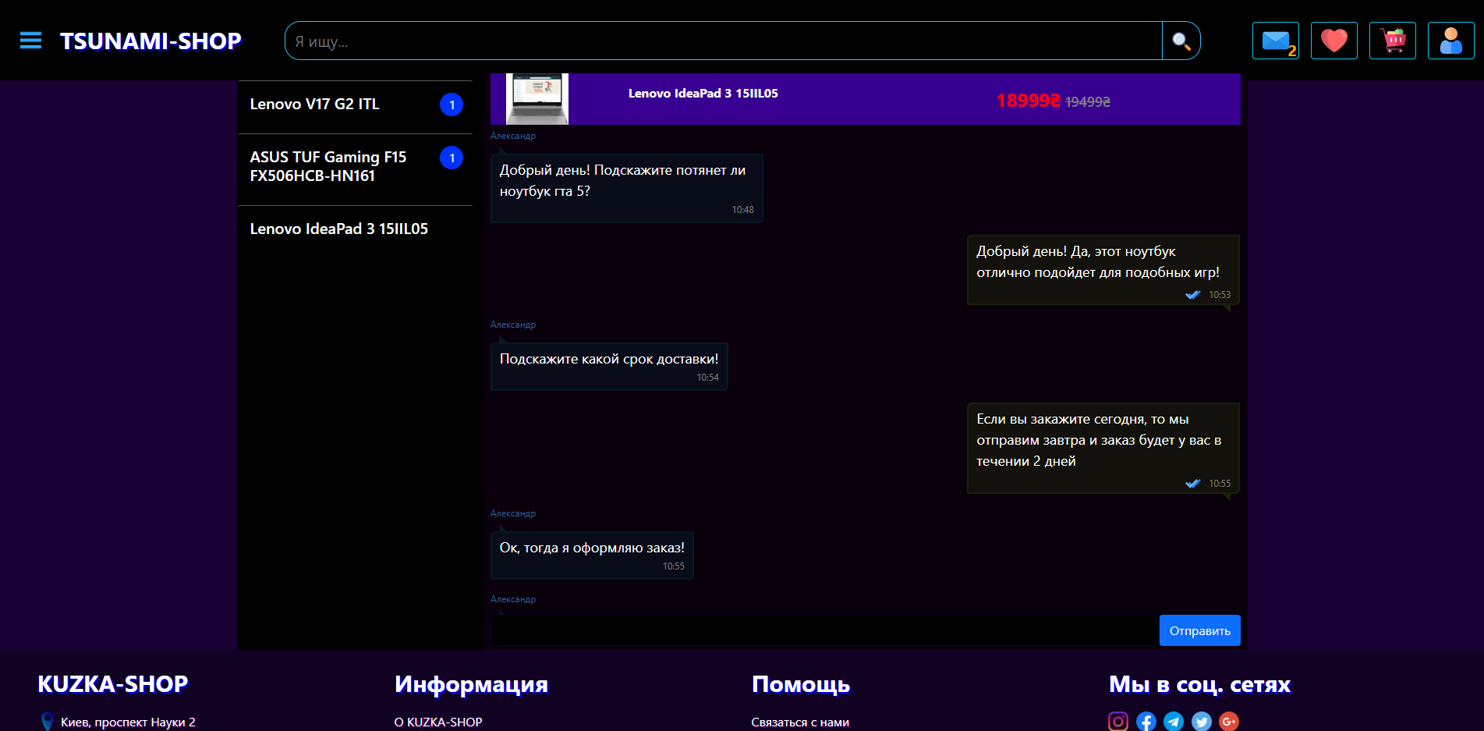
Chat - I wrote from 0

Slide 11
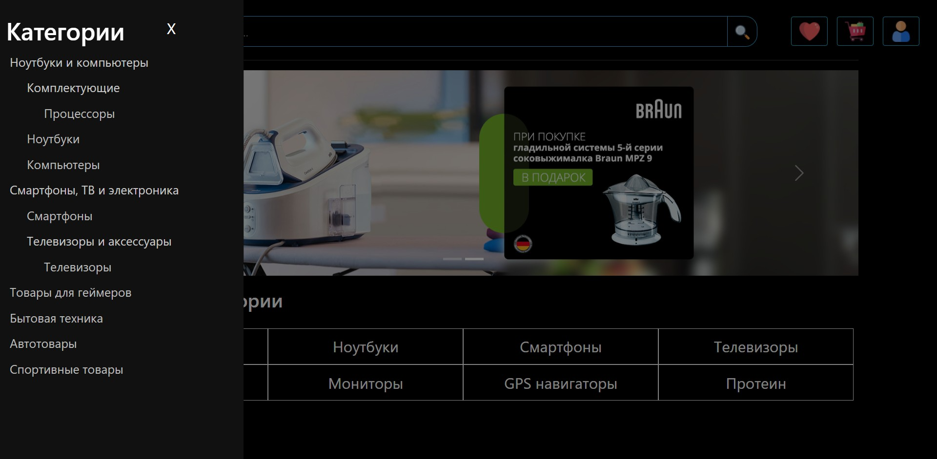
Category tree

Slide 12
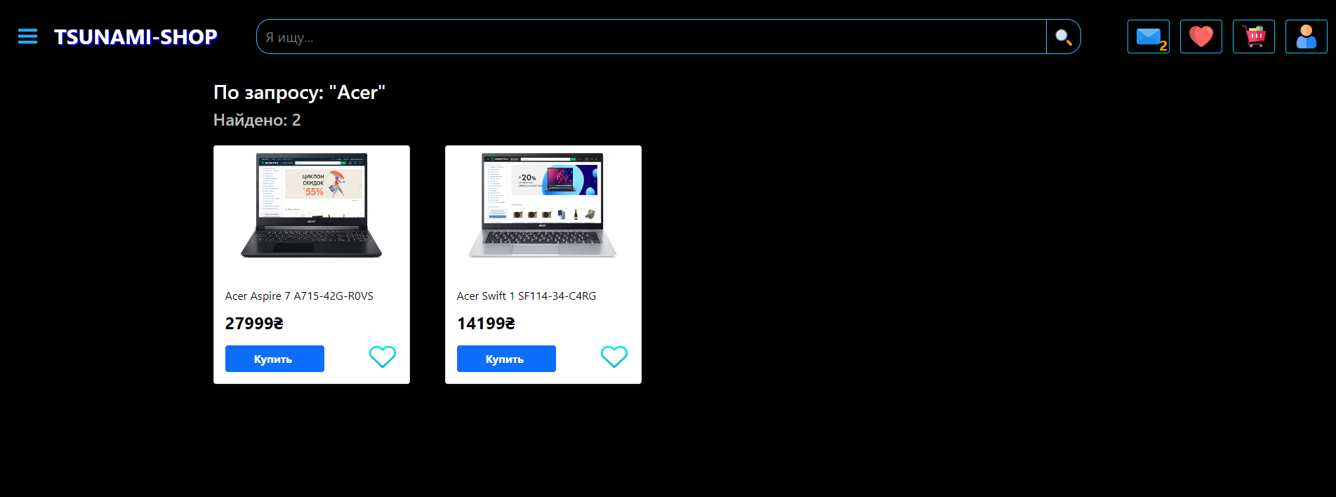
Search

Slide 13
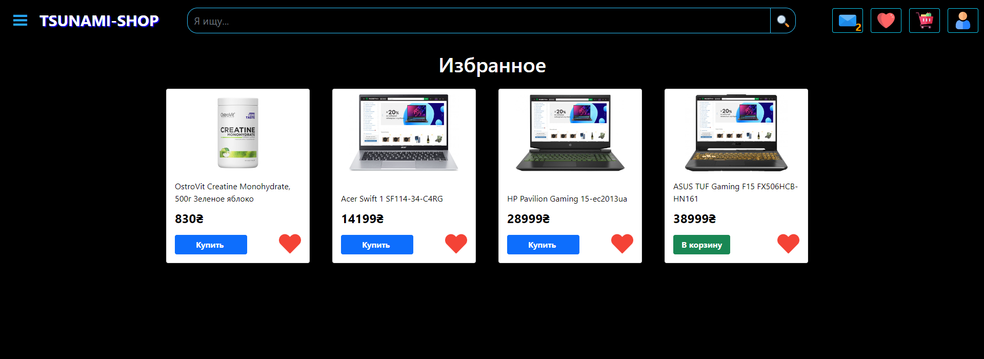
Favorites

Slide 14
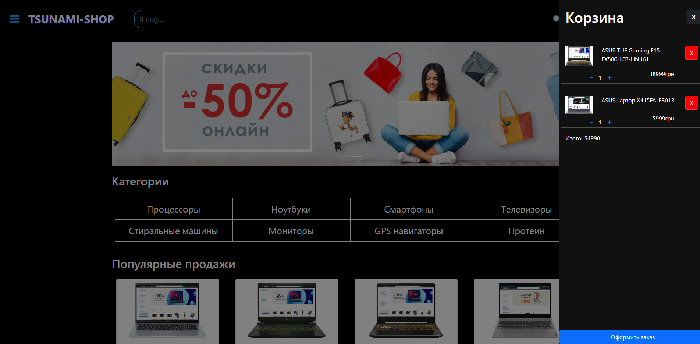
Cart

Slide 15
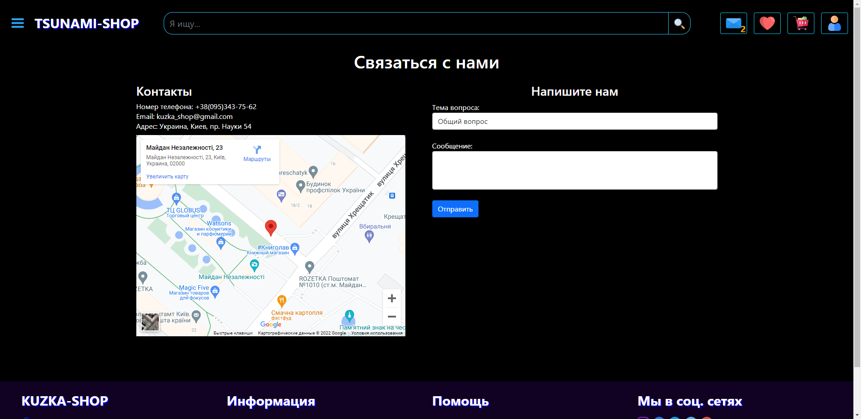
Ask a Question

Slide 16
Next will be the main menu of the user

Slide 17
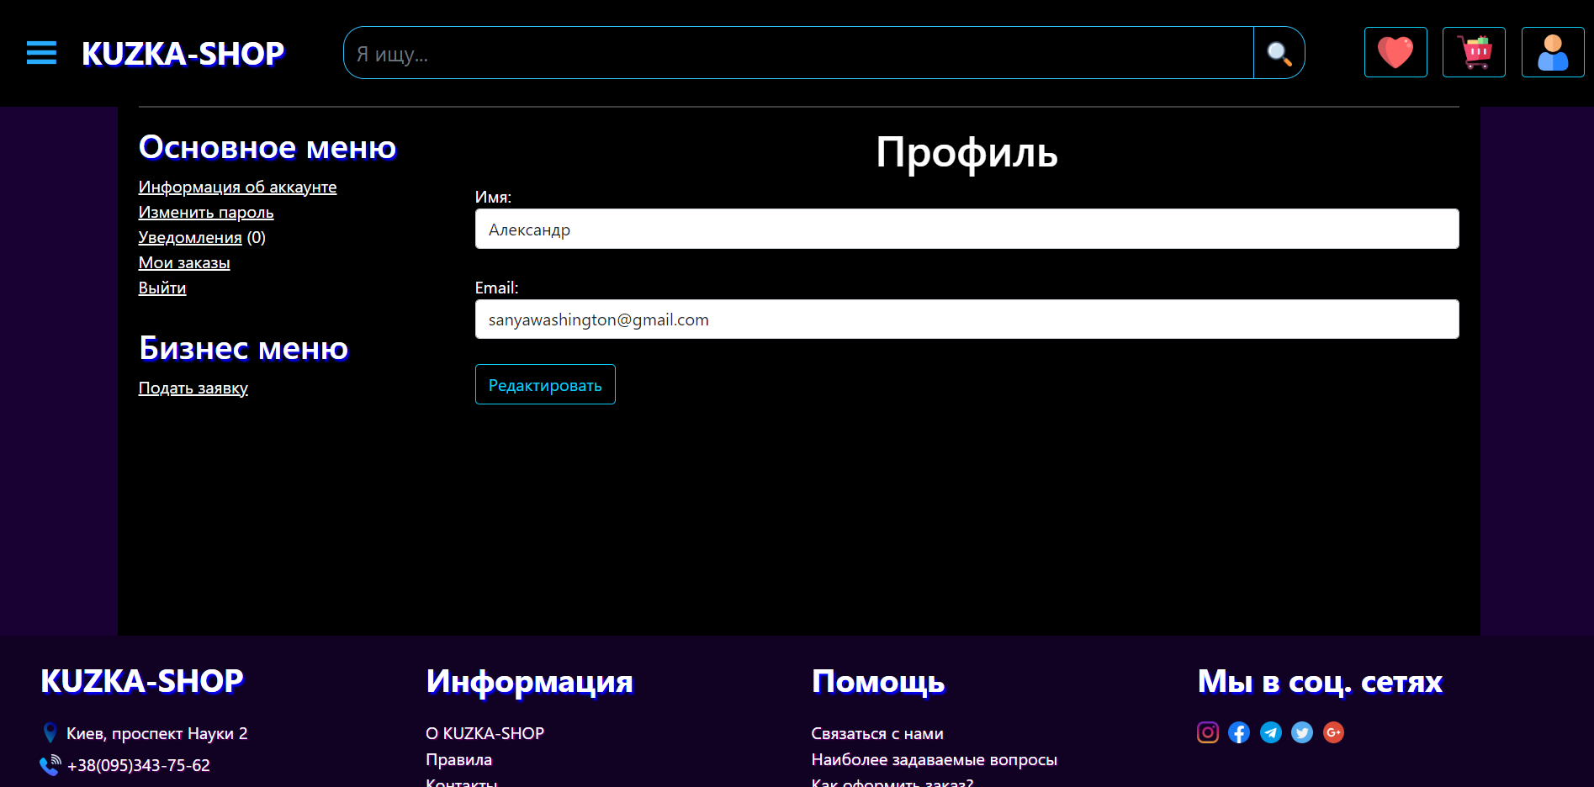
Profile

Slide 18
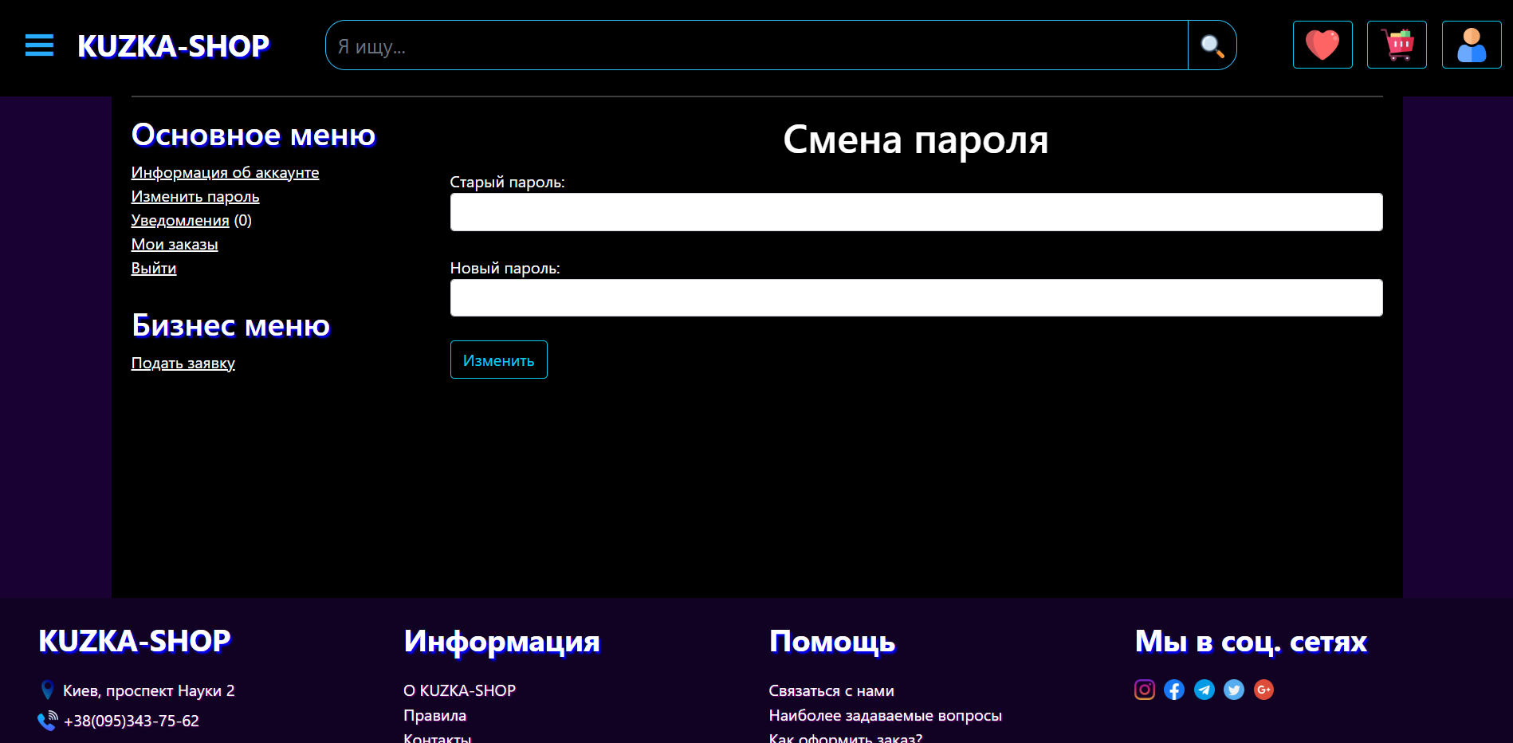
Profile(edit password)

Slide 19
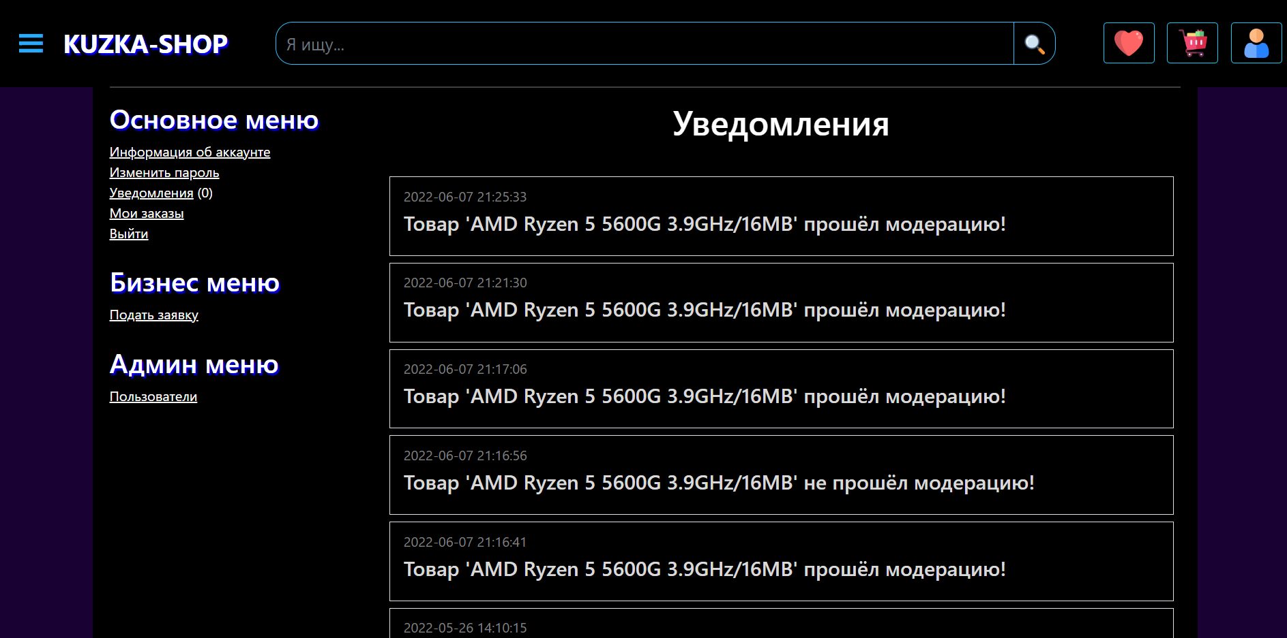
Notifications

Slide 20
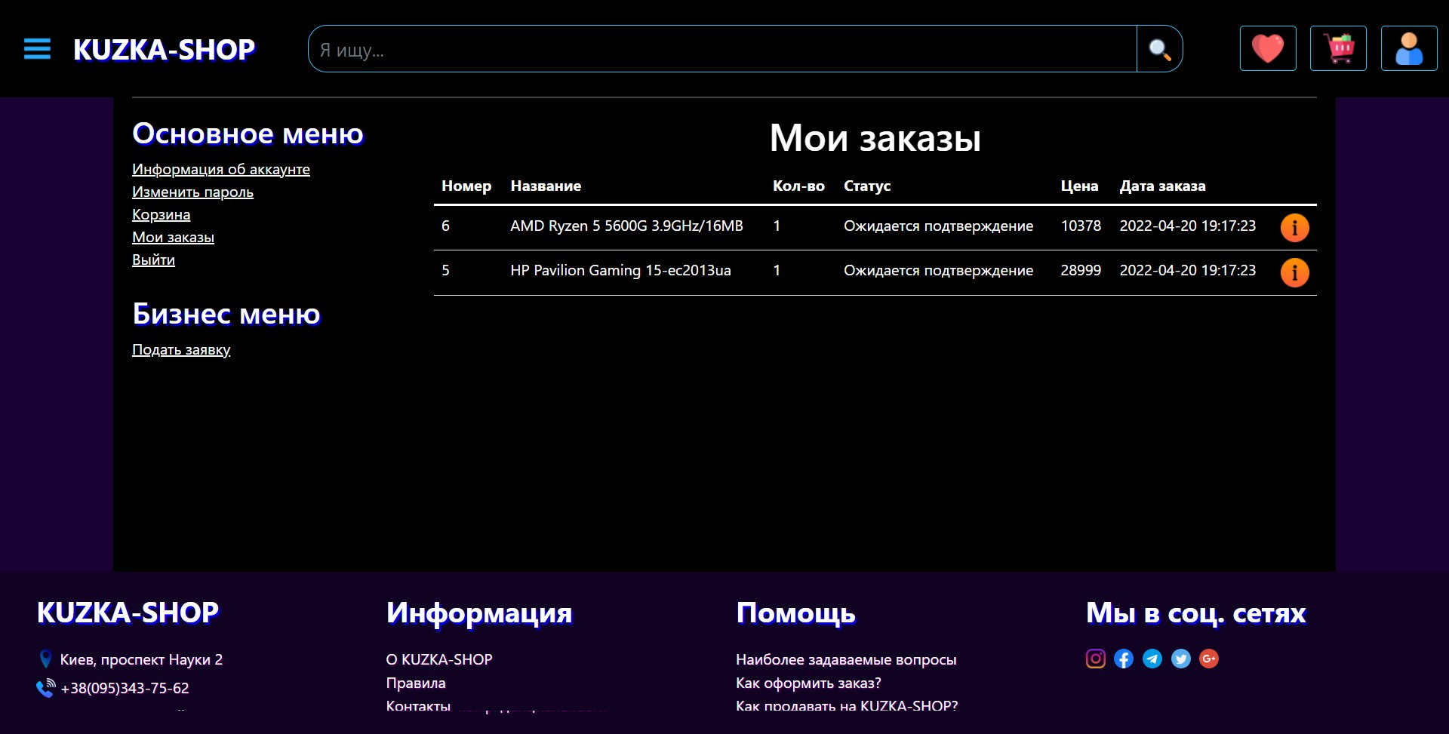
My orders

Slide 21
Next is the business menu

Slide 22
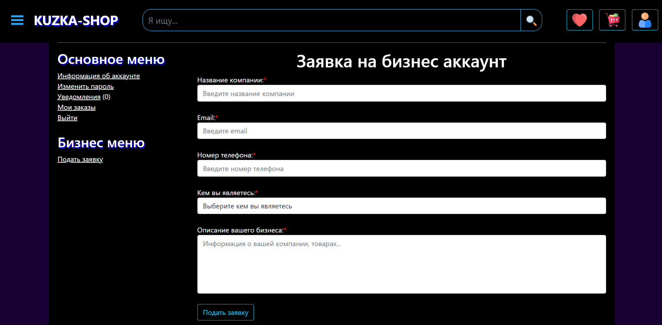
To start selling, you need to apply for a business account

Slide 23
After confirmation of the application by the moderator, you will have access to the “business menu”

Slide 24
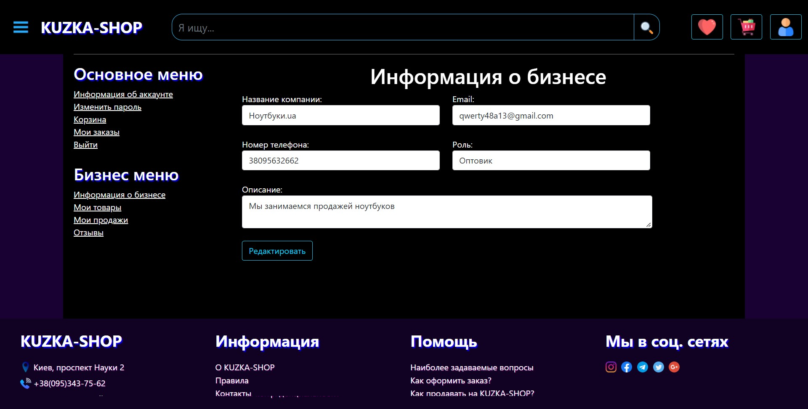
Information about business

Slide 25
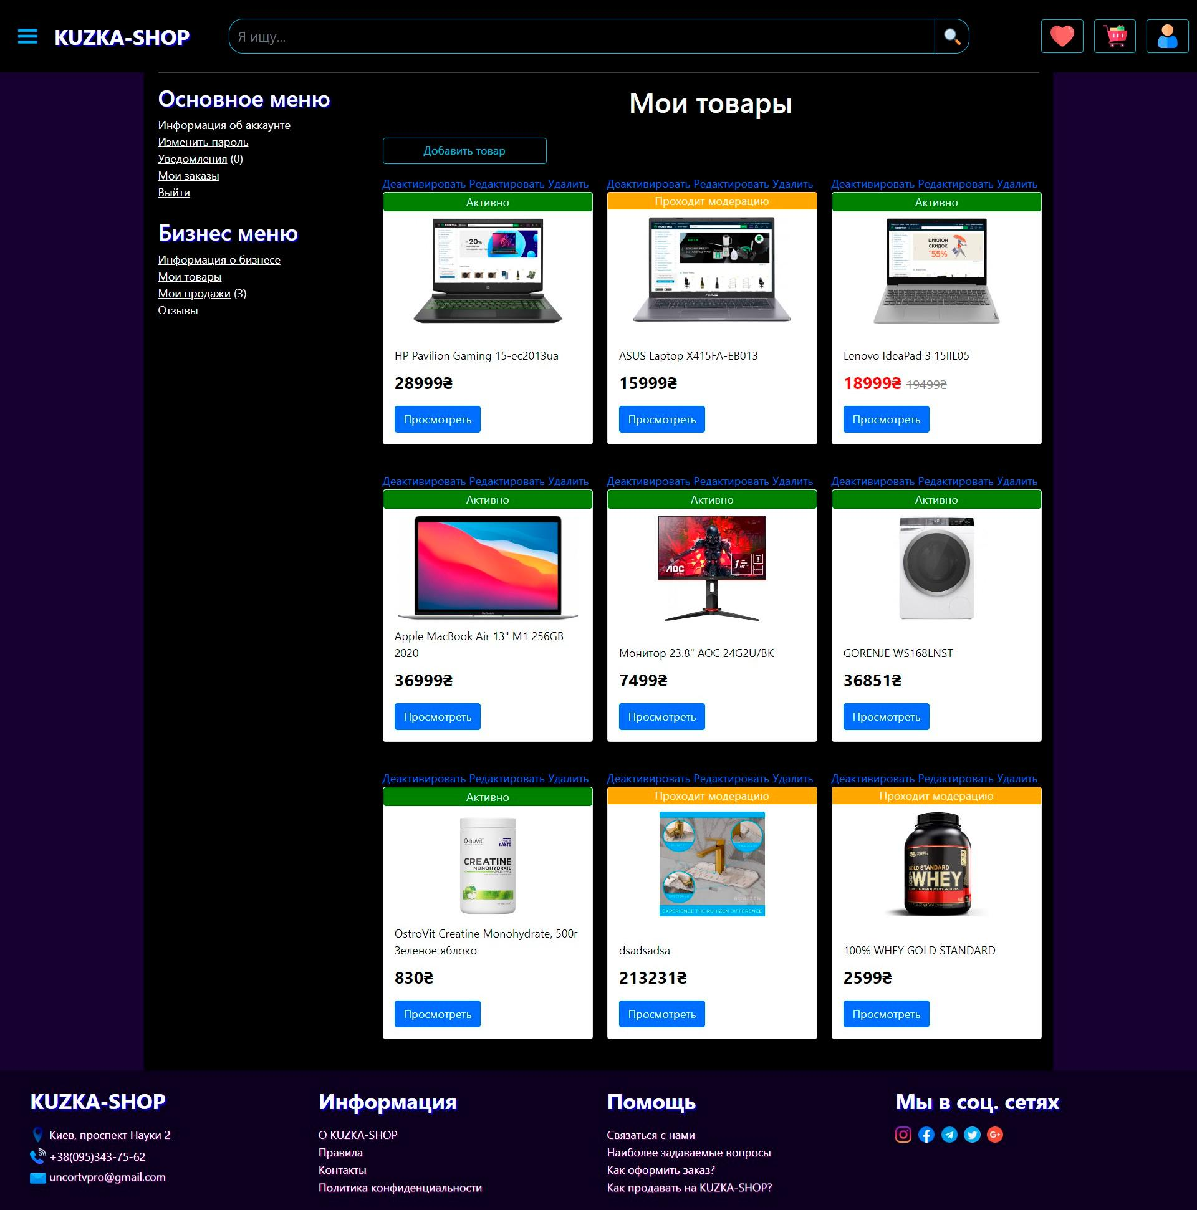
My products

Slide 26
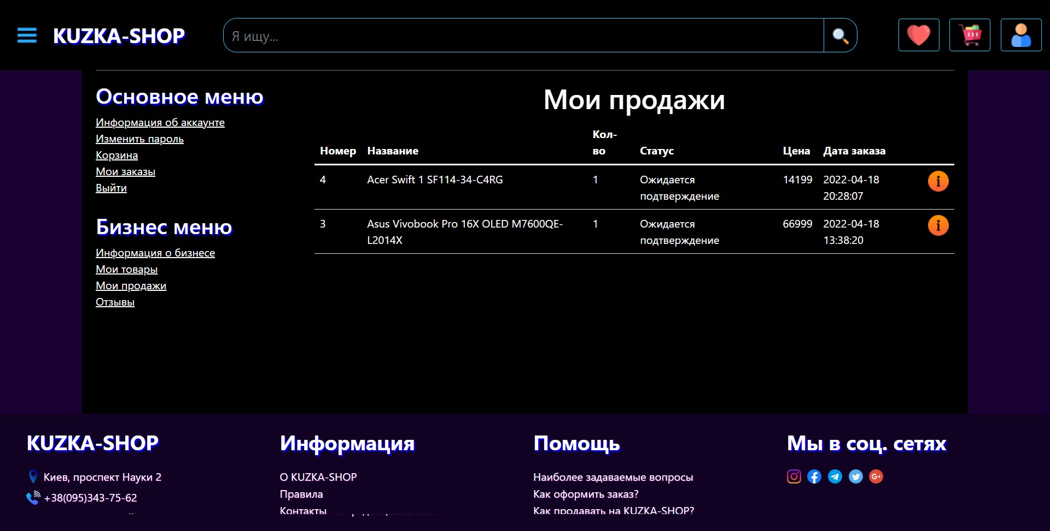
My sales

Slide 27
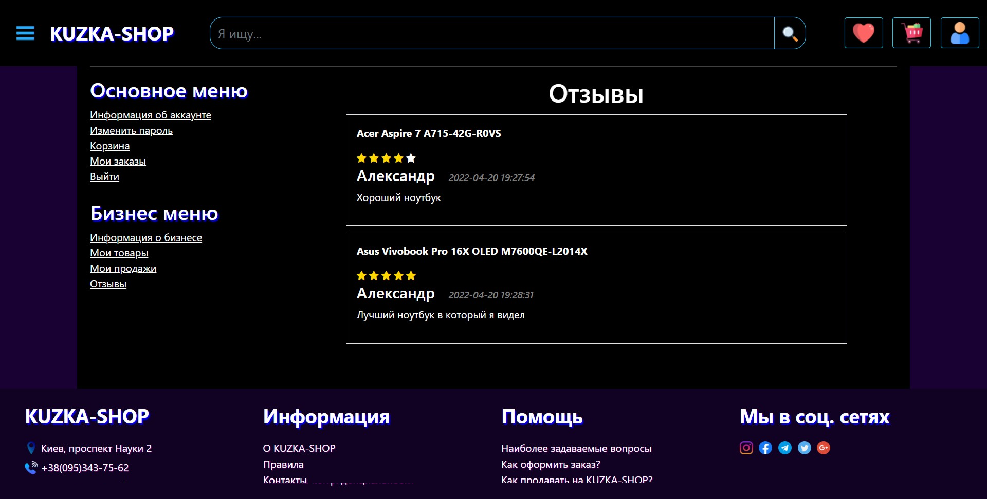
Reviews about my products

Slide 28
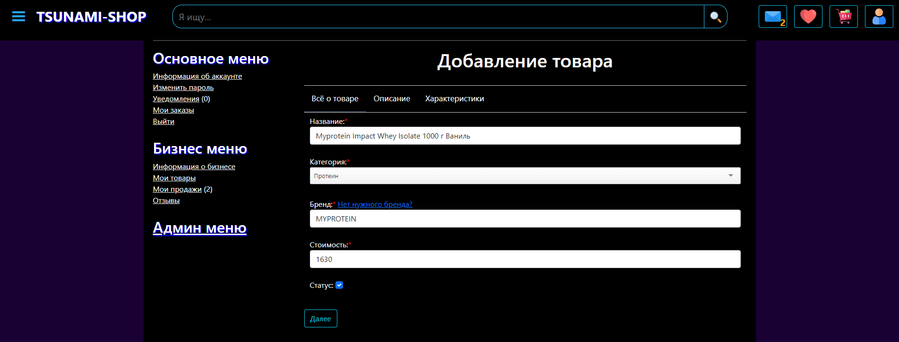
1.Create product(main information)
-Title, Category, Brand, Price

Slide 29
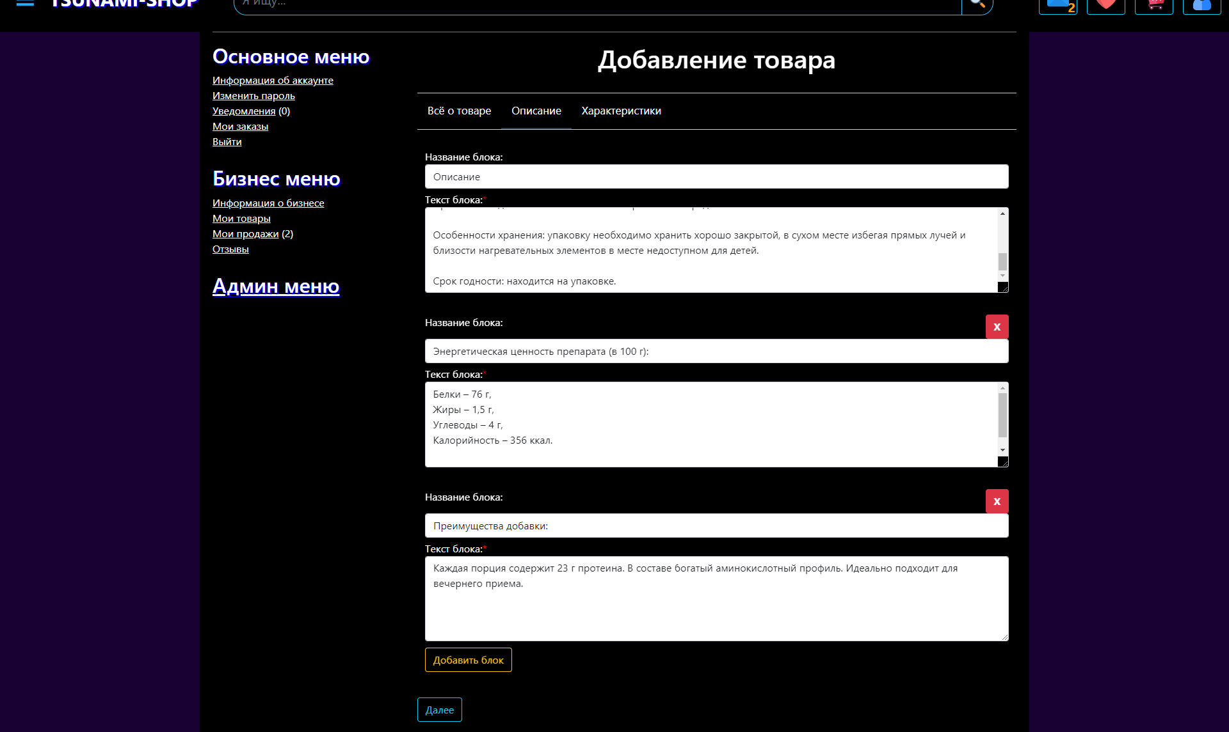
2. Create product(description blocks)

Slide 30
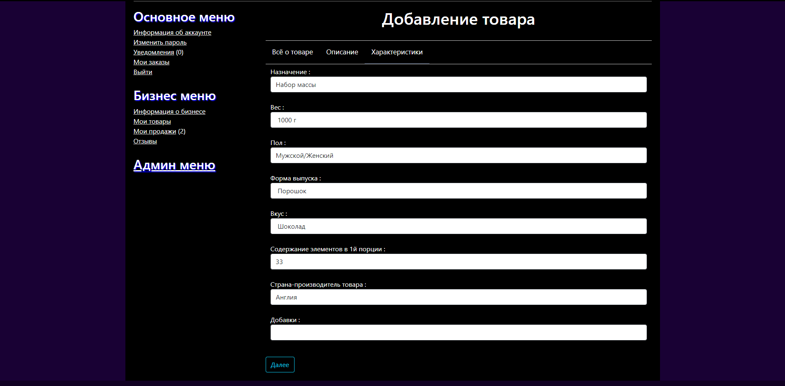
3. Create product(characteristics)
-specifications for each product are different

Slide 31
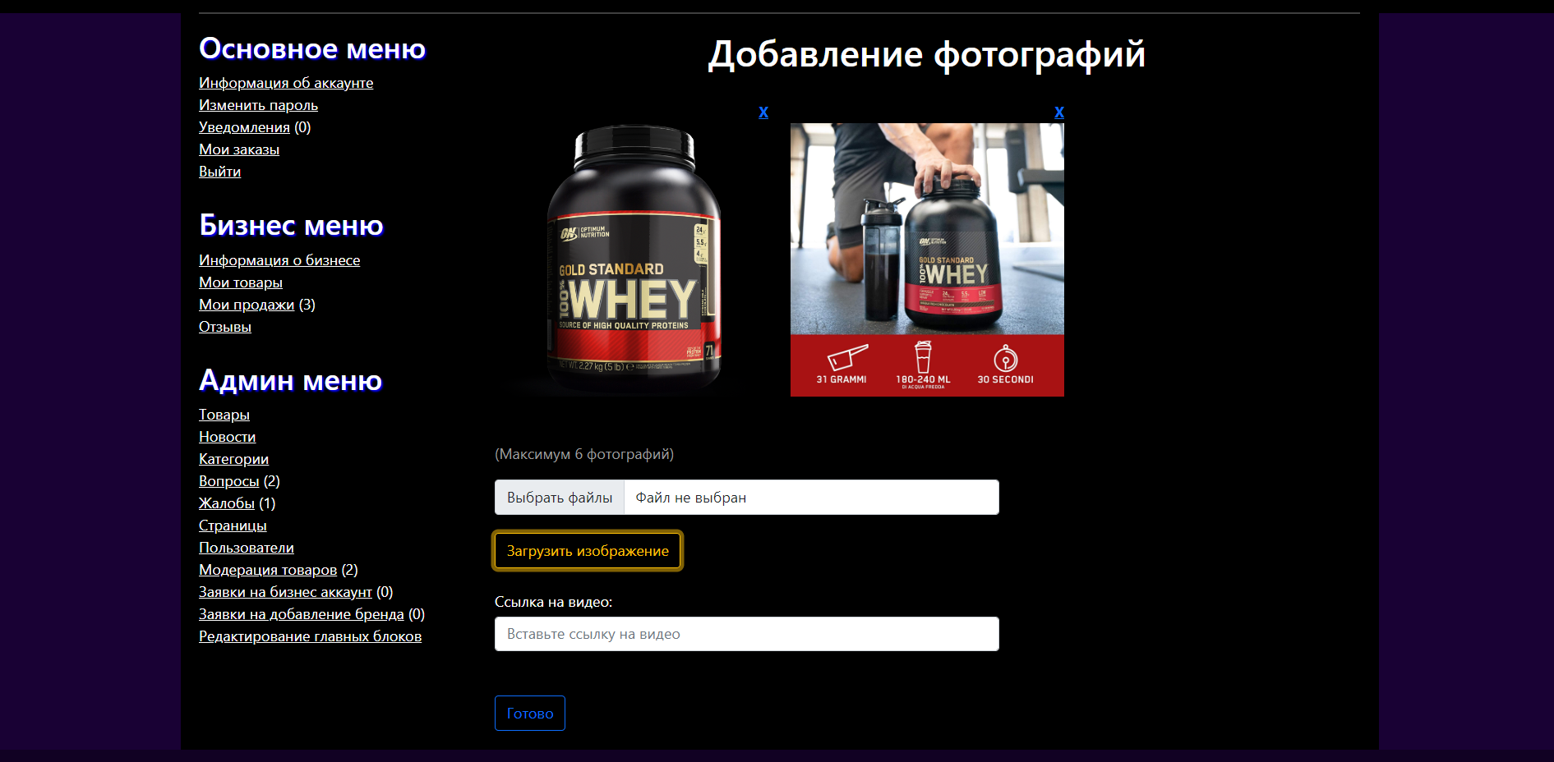
4. Create product(images)

Slide 32
Next is the admin menu

Slide 33
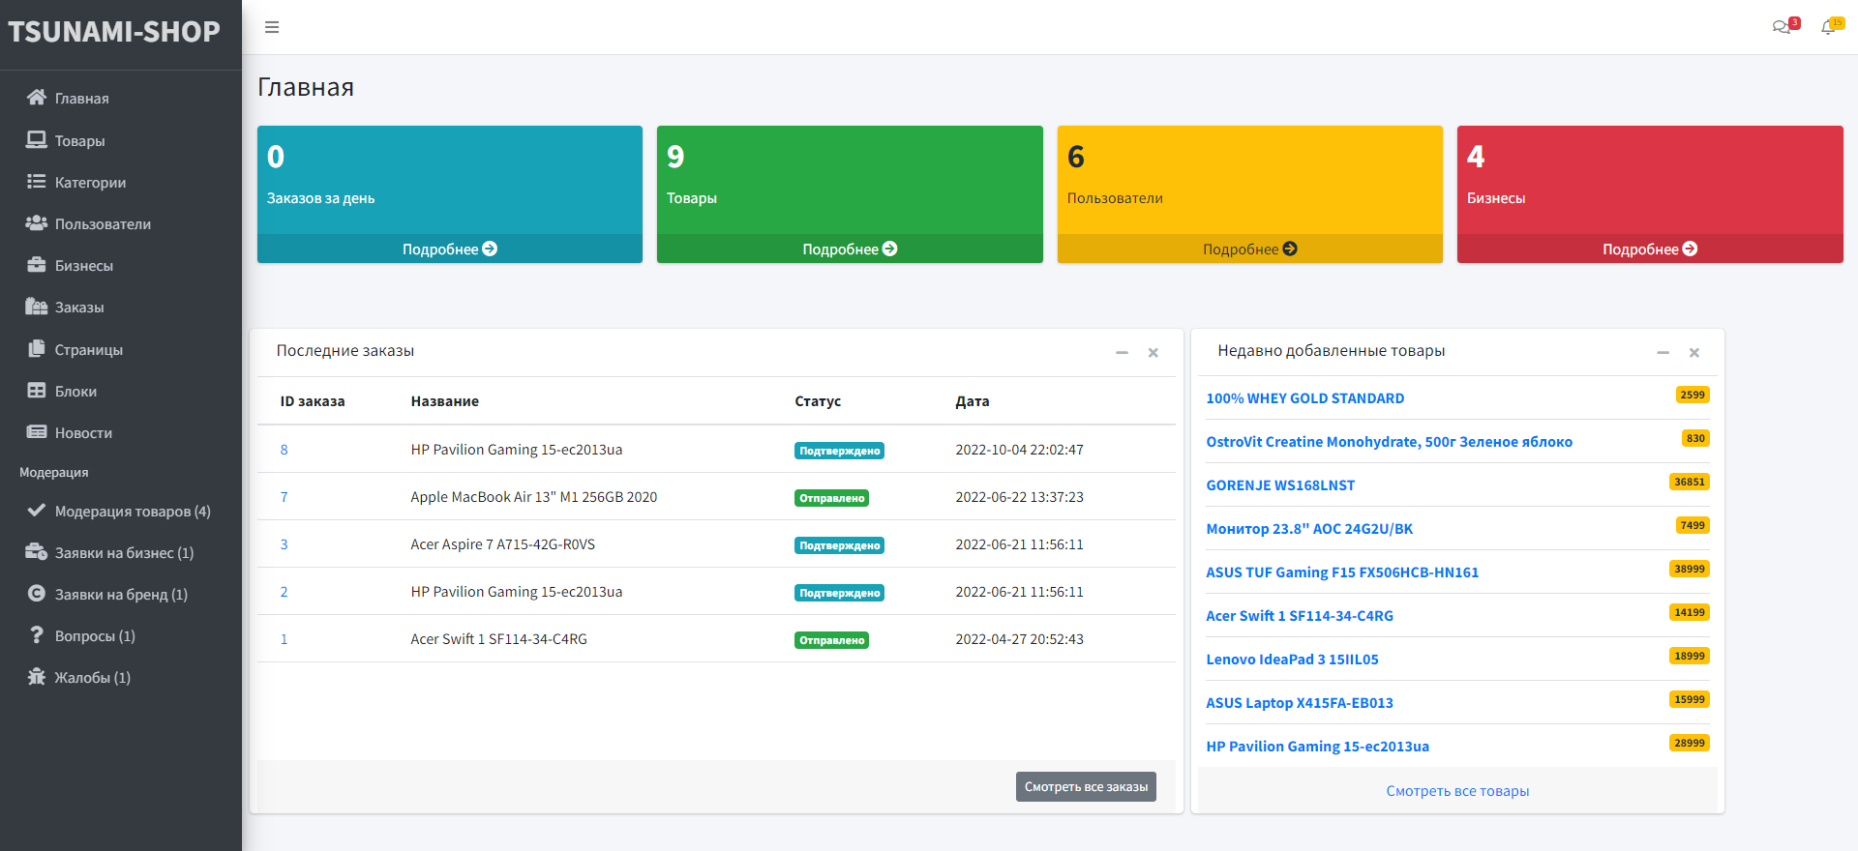
Main admin page

Slide 34
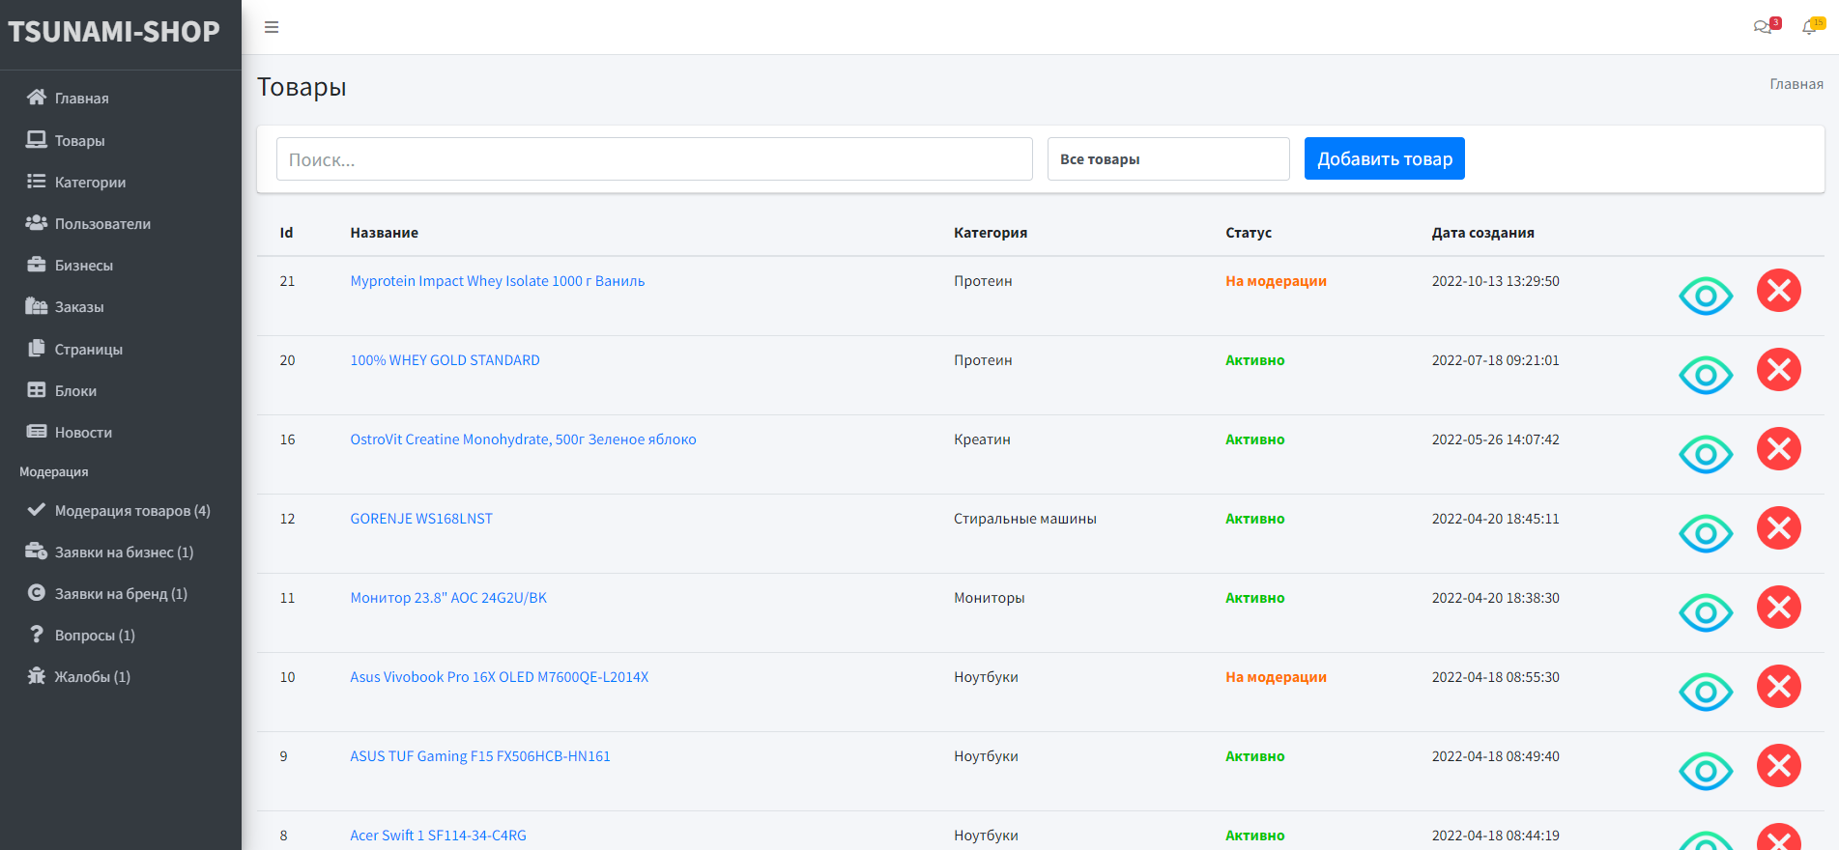
Database with all products

Slide 35
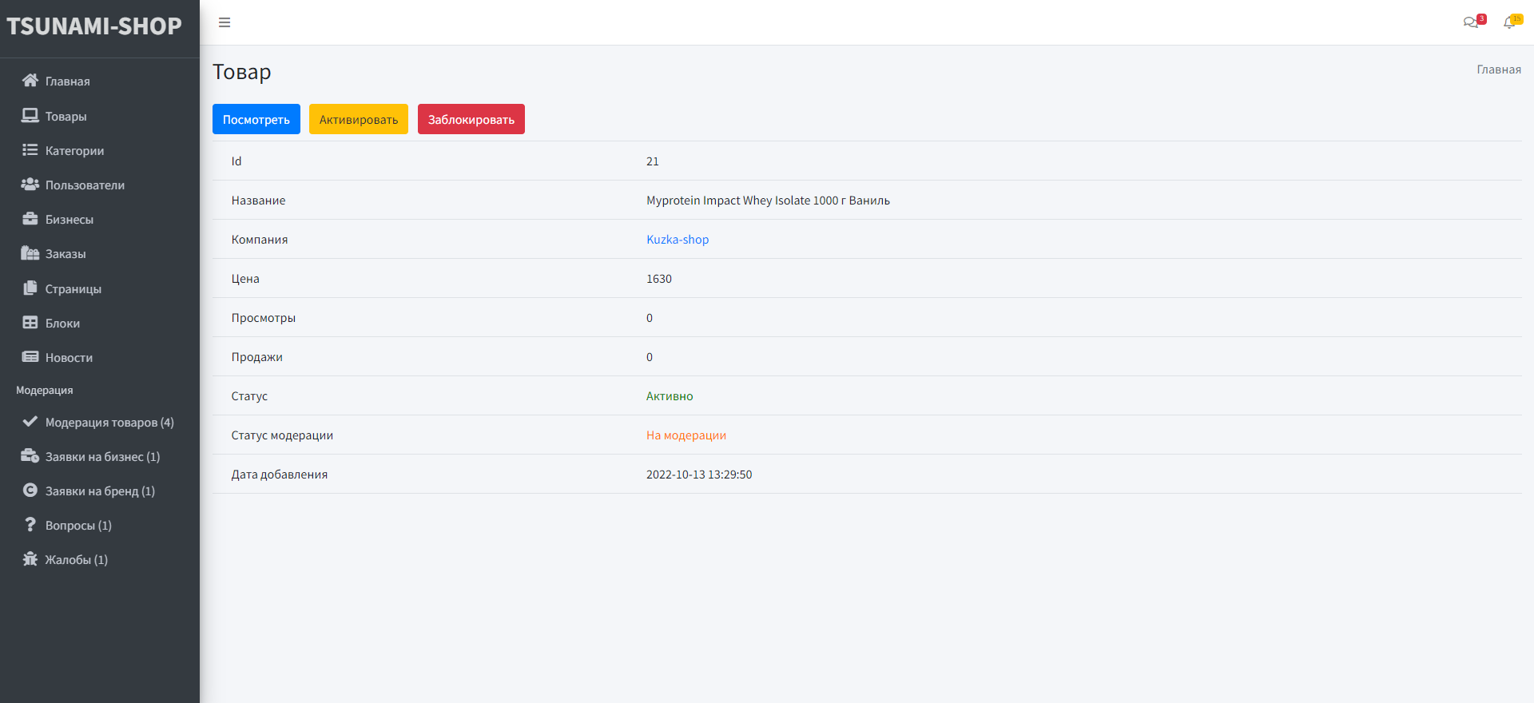
Info about product(Admin)

Slide 36
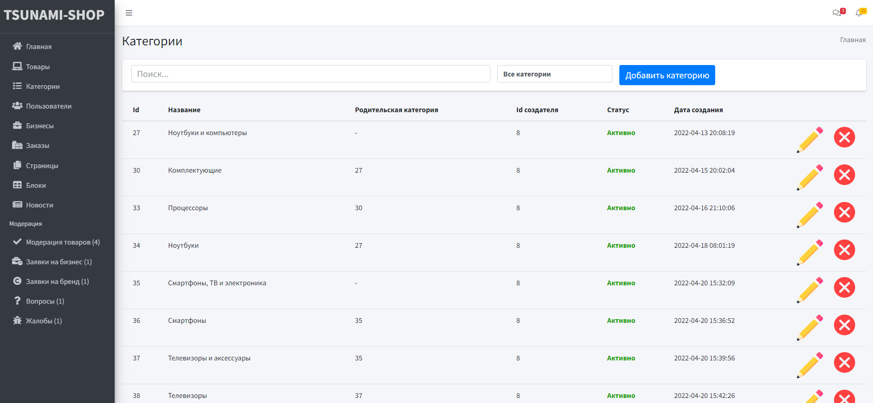
Database with all categories

Slide 37
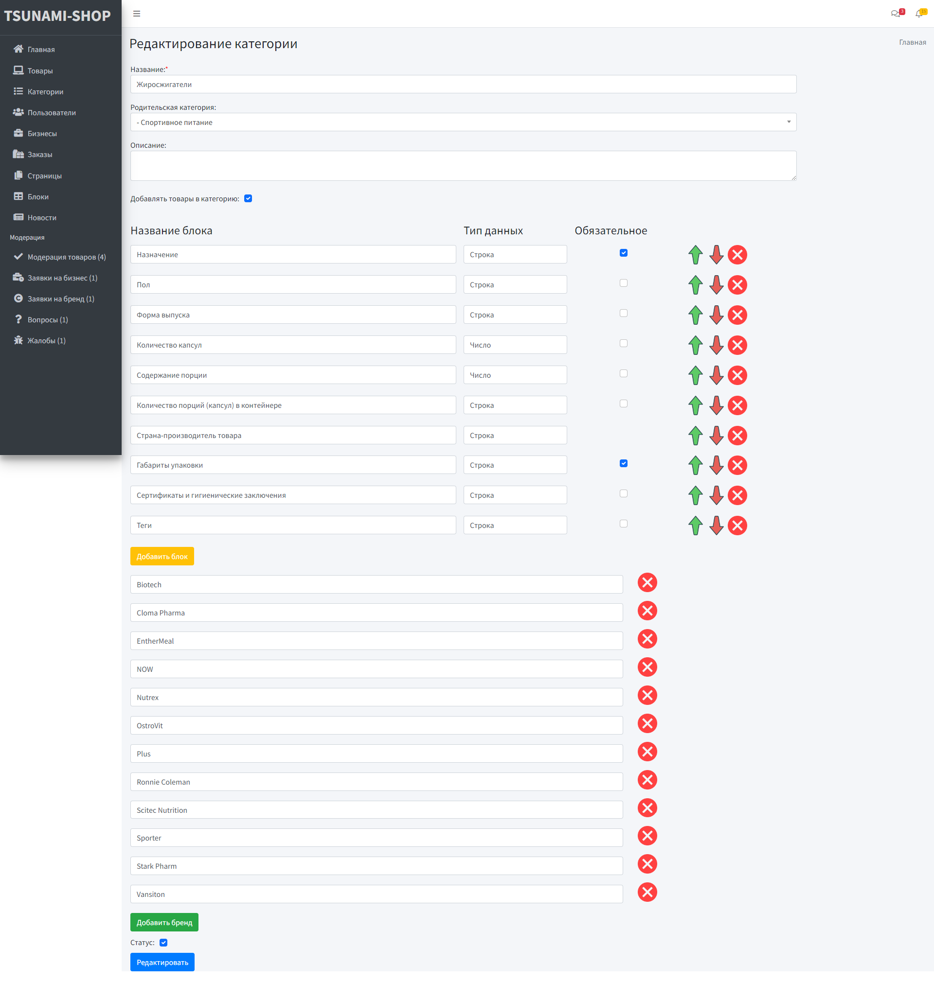
Create/Edit category
Buttons:
‘Добавить блок’ - add feature item to category
‘Добавить бренд’ - add brand to category

Slide 38
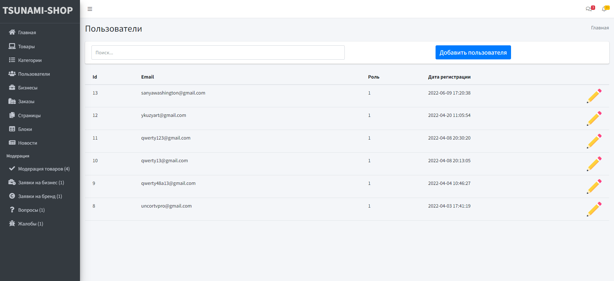
User database

Slide 39
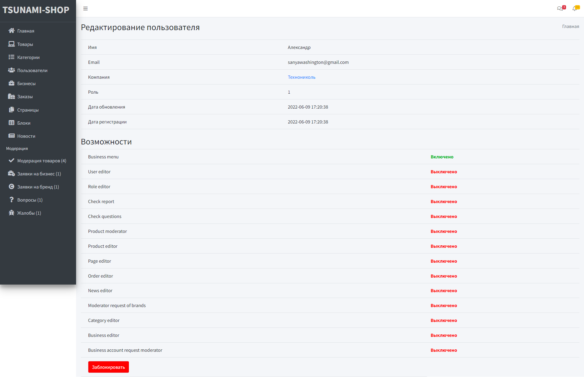
Information and edit roles of user

Slide 40
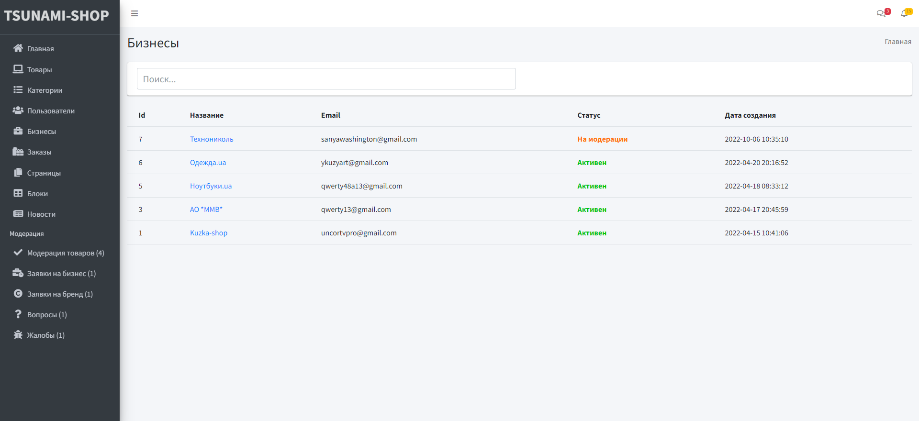
Business list

Slide 41
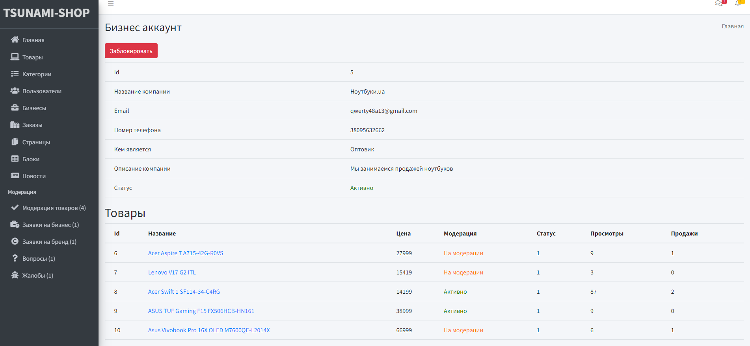
Information about business

Slide 42
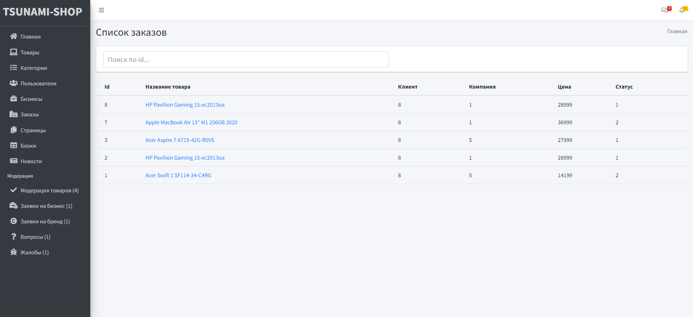
Order list

Slide 43
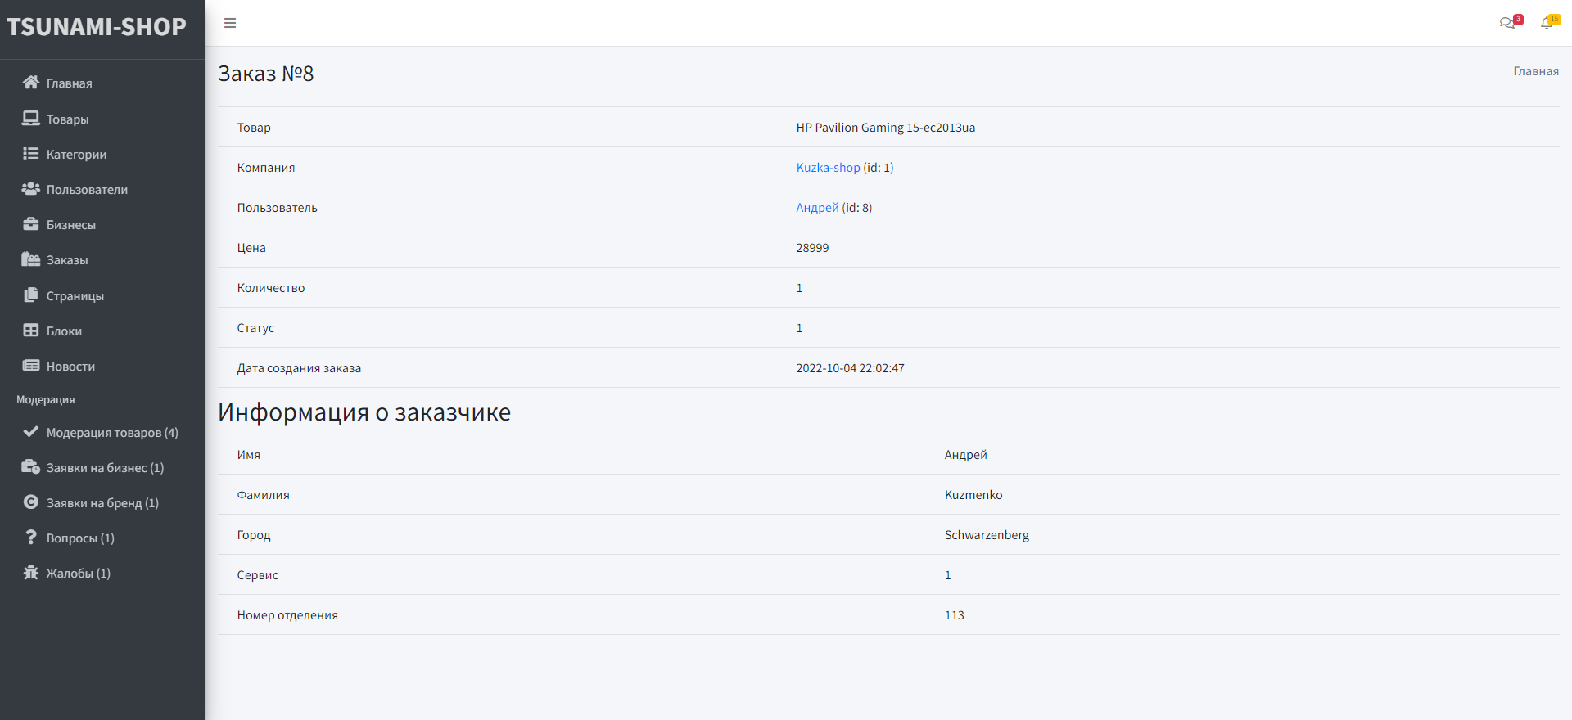
Info about order

Slide 44
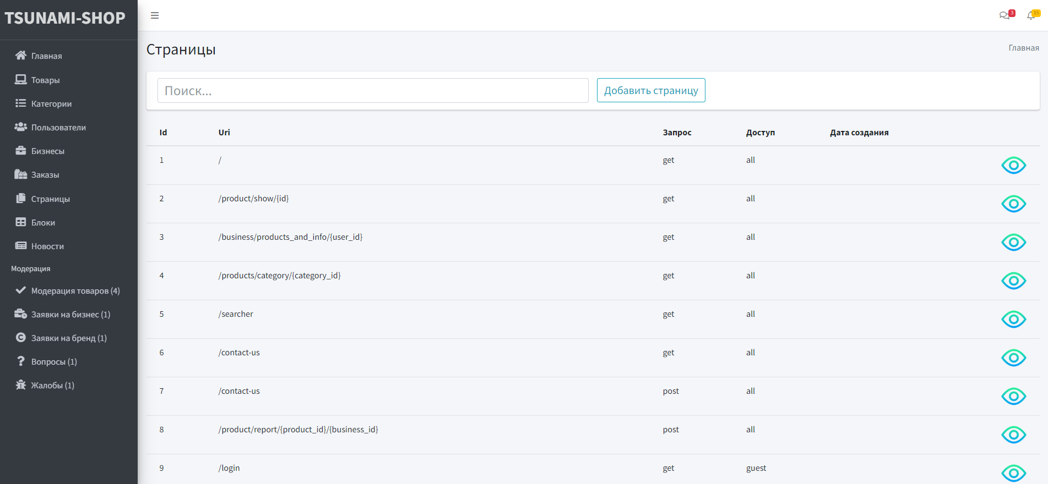
Pages

Slide 45
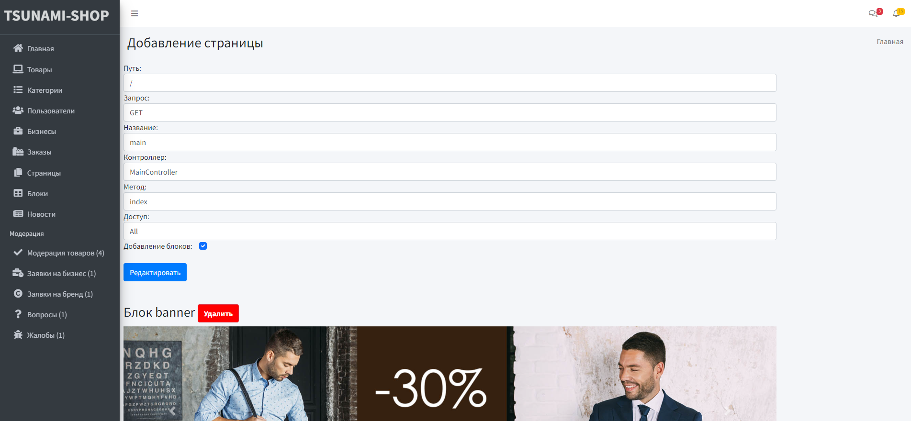
Edit page

Slide 46
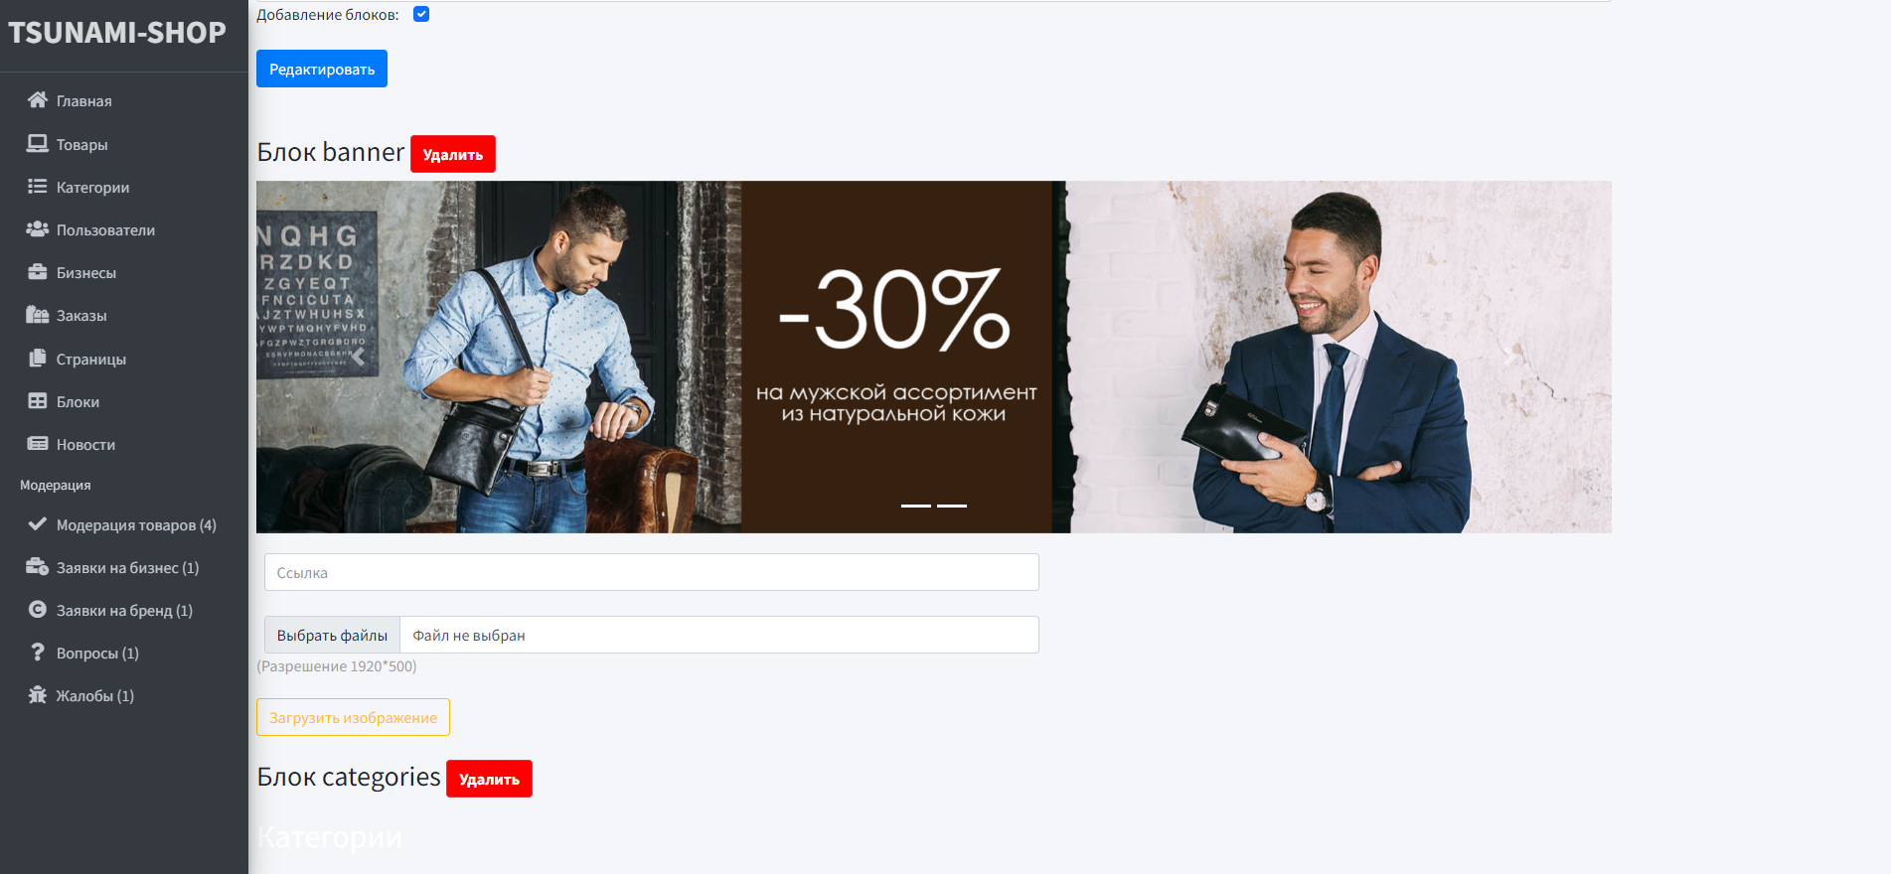
Edit page(blocks)

Slide 47
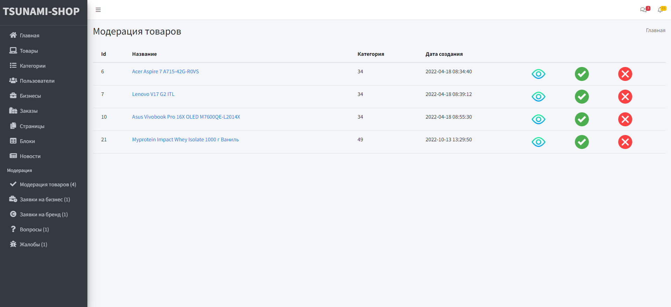
Moderation product list

Slide 48
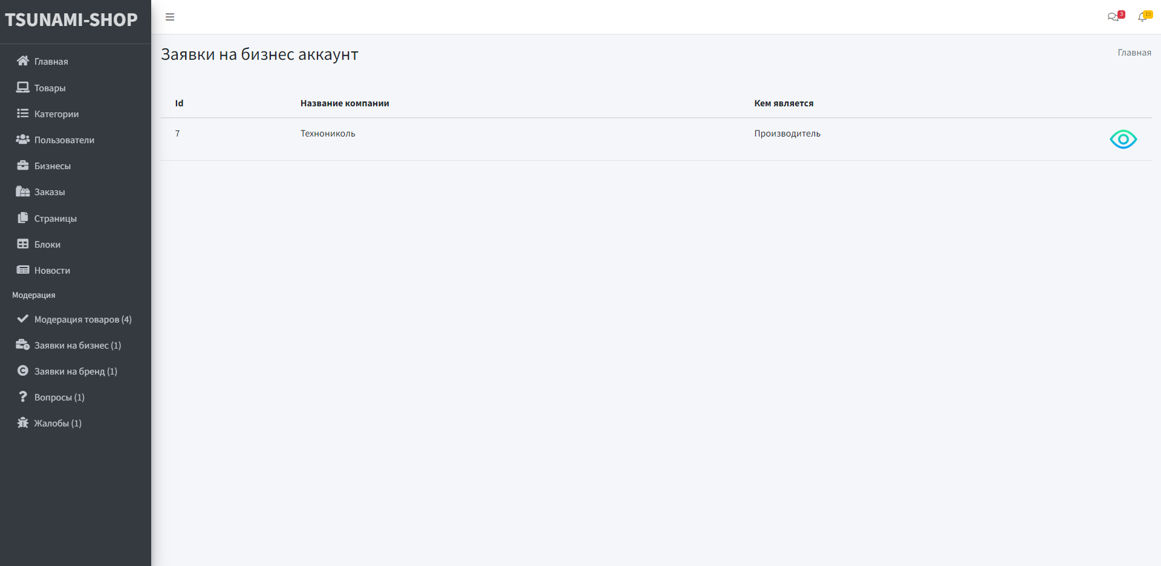
Moderation on business account(1)

Slide 49
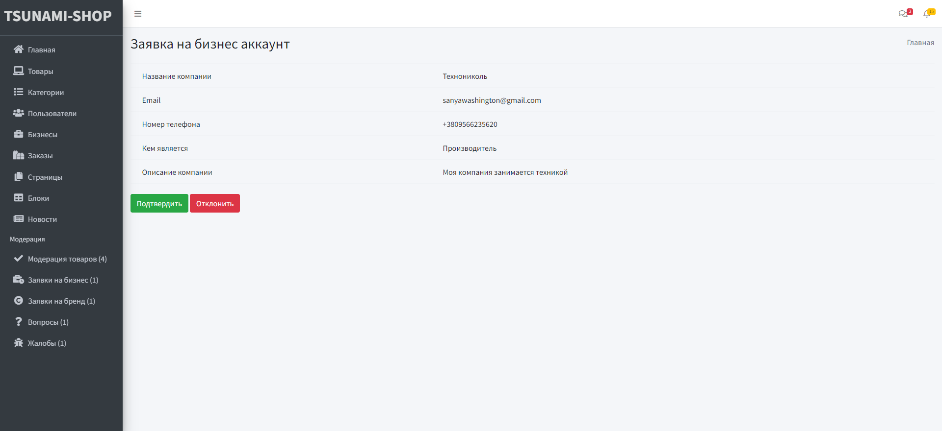
Moderation on business account(2)

Slide 50
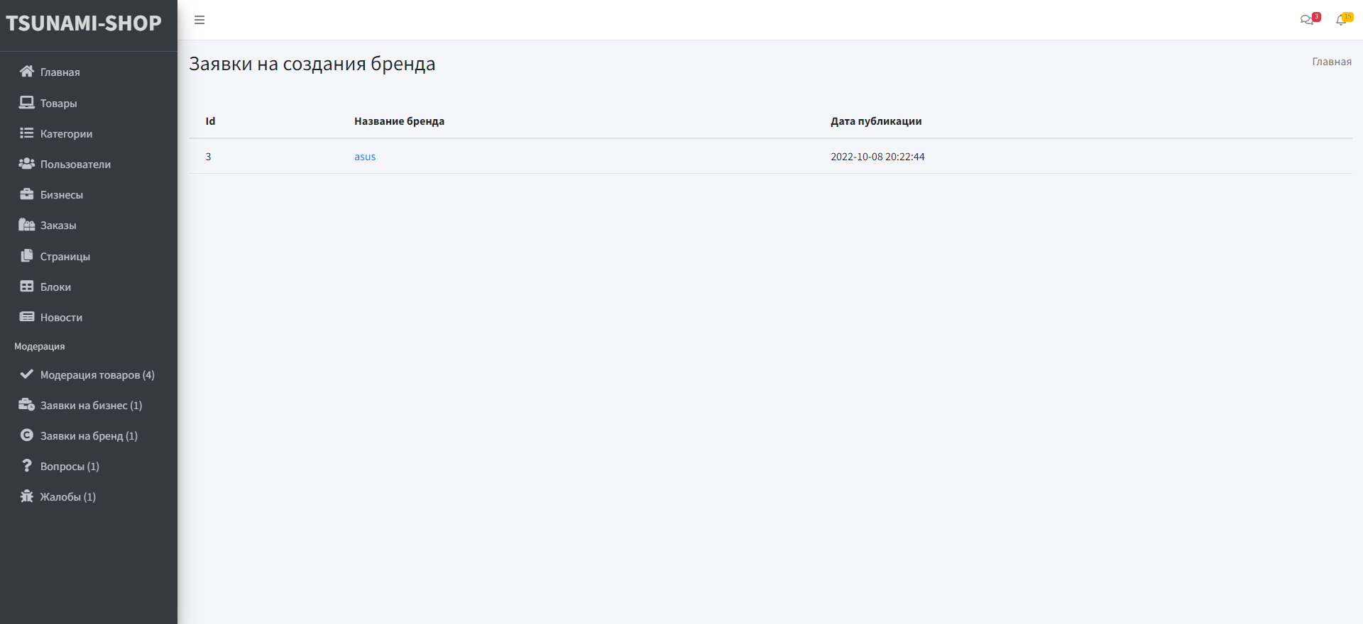
Moderation on brand creation

Slide 51
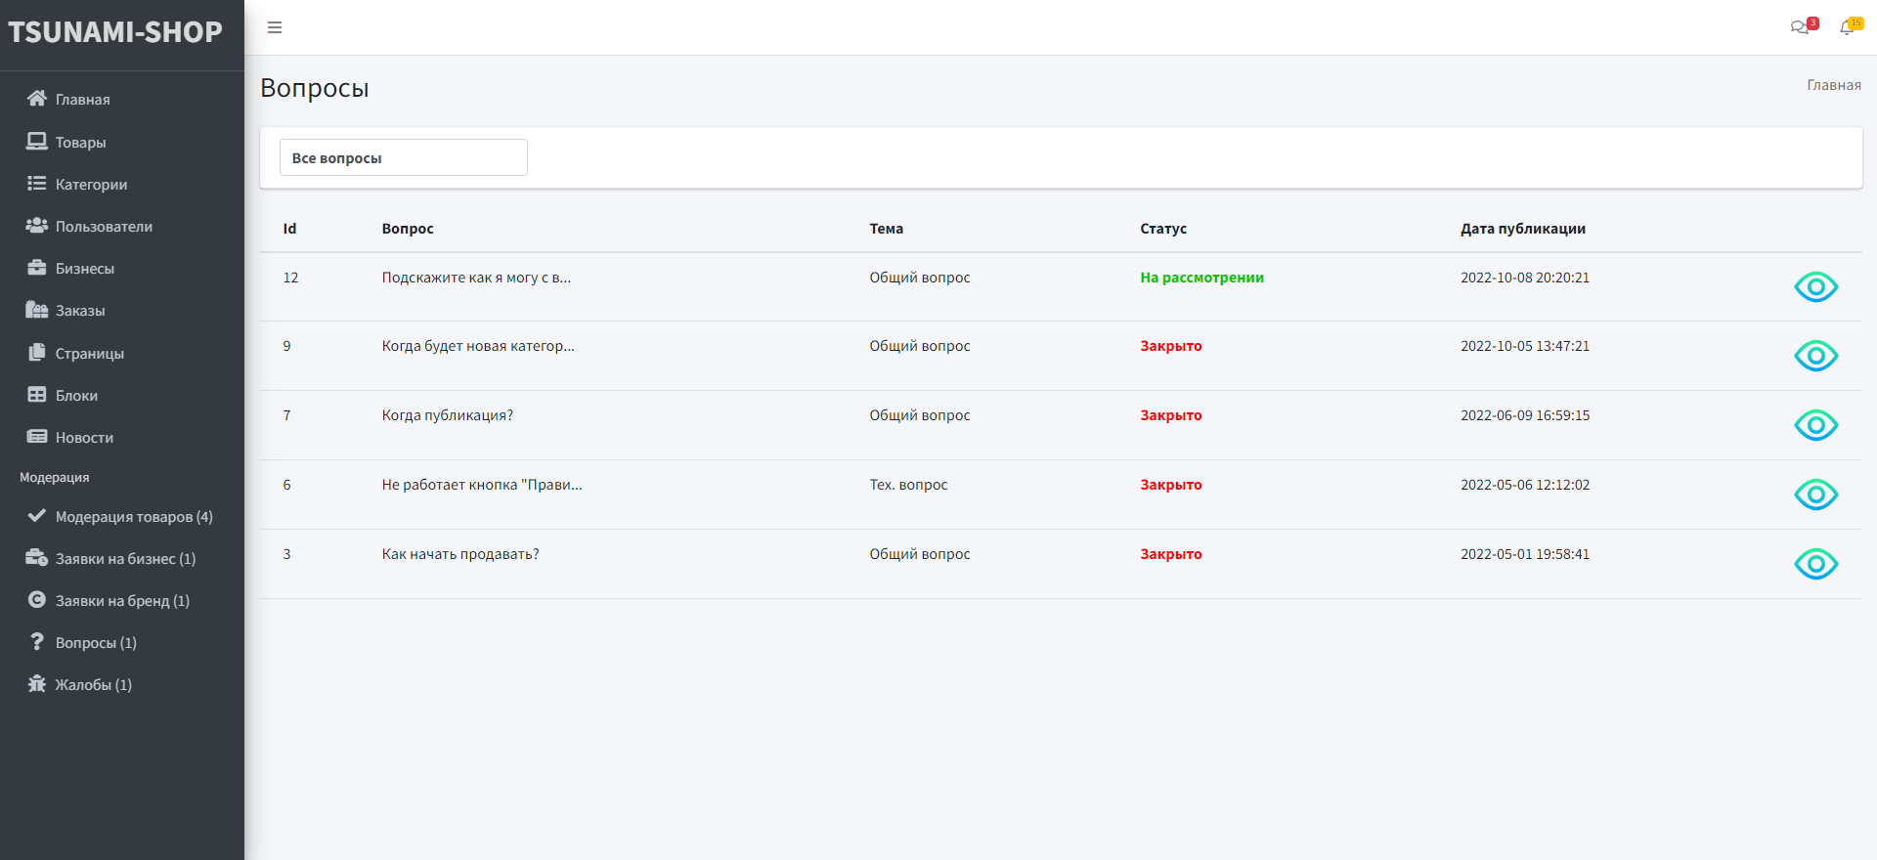
Questions from users

Slide 52
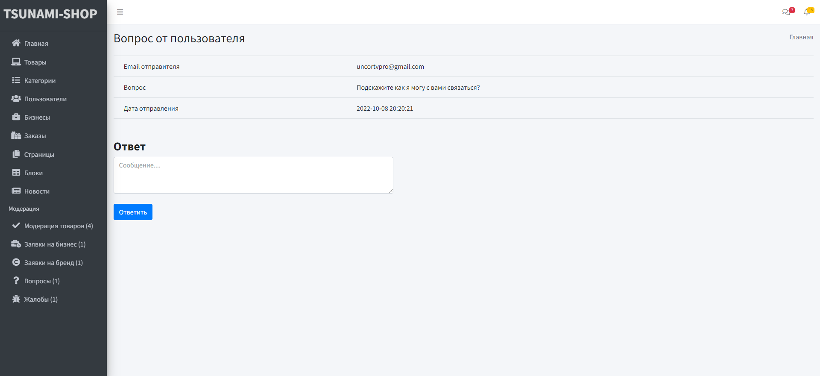
Question show

Slide 53
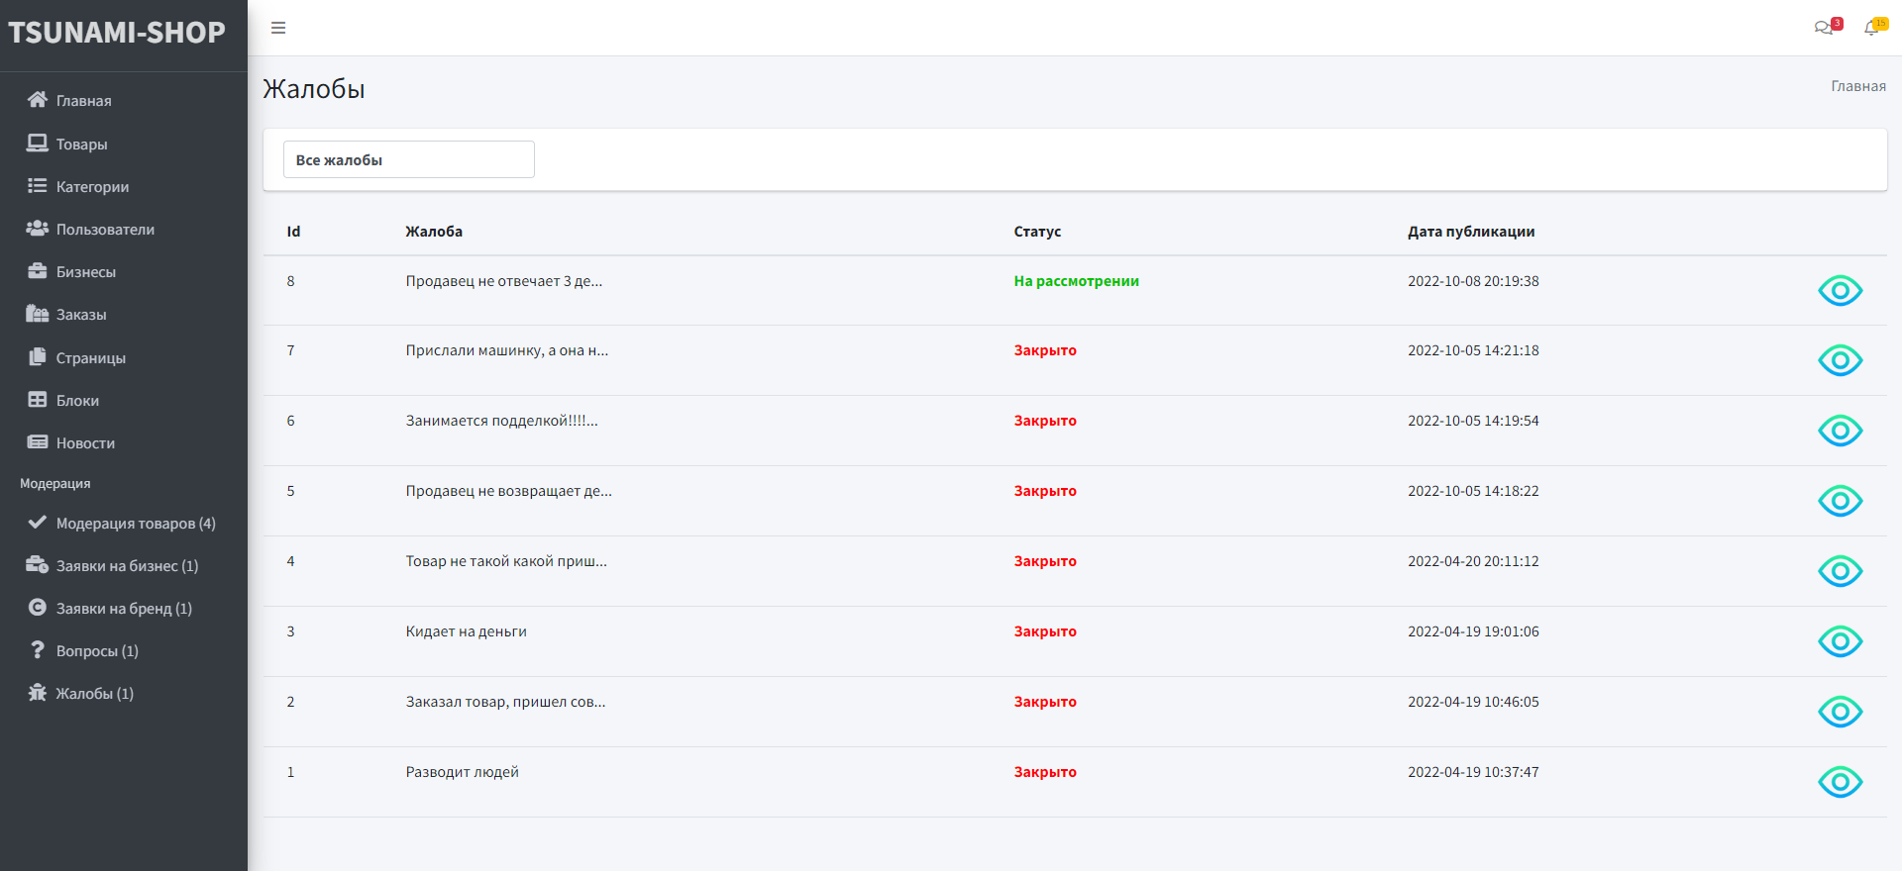
Complaints

Slide 54
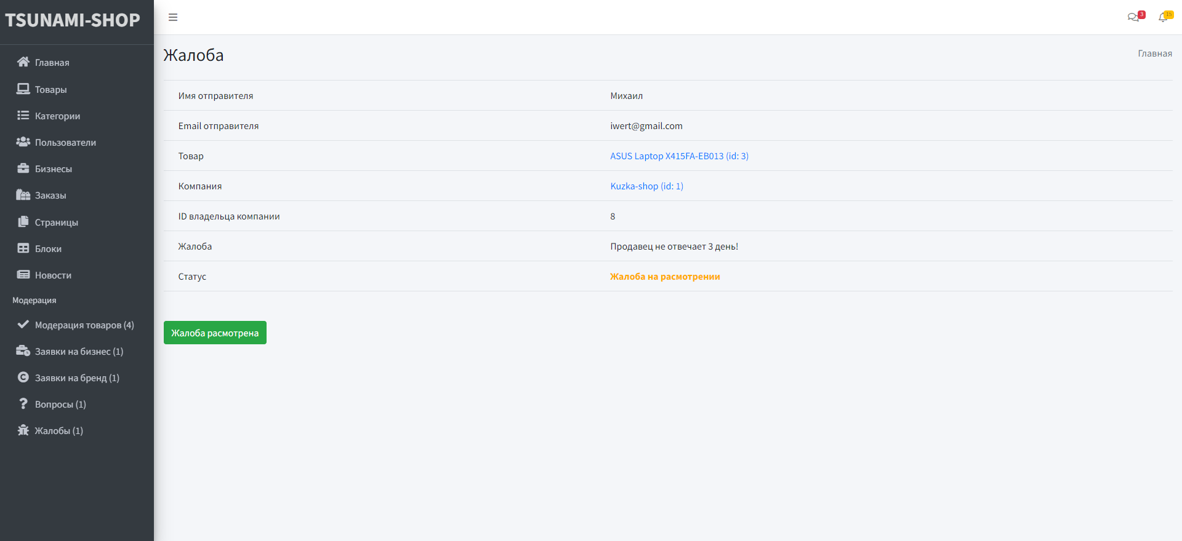
Complaint

